Slide 1
LUBRICATION

Slide 2
Lubrication - Importance
When two metallic parts make a contact and move relative to each other, due to surface irregularities frictional heat is generated.
This results in a loss of power transmitted between them.
Frictional losses can be minimized by maintaining a layer of unguent known as lubricant between the two moving surfaces.
The lubricant prevents the two contact surfaces from coming into direct contact with each other.
A film of lubricant is said to be present between the contact surfaces.

Slide 3
Types of lubricants
Type of lubricant | Examples | Application
Solid lubricants | Wax, graphite, graphite with grease | Used where oil film cant be maintained due to high pressure
Liquid lubricants | Mineral oils, vegetable oils, animal oils | Ordinary machinery, steam & I C engines.
Semi solid lubricants | Grease | Used where low speed & high pressure exist.

Slide 4
Properties of a lubricant
Viscosity:
It is the property of lubricant by virtue of which it offers resistance to shear.
If the viscosity is too low, then a liquid film cant be maintained between the two moving surfaces.
If the viscosity is too high, then it will offer great resistance to the moving surfaces of the parts.
Viscosity decreases with increase in temperature
So viscosity of a good lubricant should not change with varying operating temperature

Slide 5
Flash & fire points:
Flash point: It is the lowest temperature at which the fumes of oil will produce a flash but will not catch fire when the flame is brought in contact with it.
Fire point: It is the lowest temperature at which the oil fumes catch fire & will continue to burn when the flame is brought in contact with it.
So a good lubricant should posses a flash point temperature higher than the temperature at which it is used.

Slide 6
Oiliness:
Oiliness: It is the ability of the lubricating oil to adhere to the rubbing surfaces.
When a thin film of oil is subjected to high pressure, the oil film will be squeezed out of the lubricated surfaces.
So a good lubricant should adhere to the surfaces and maintain an oil film between the rubbing surfaces.

Slide 7
Cloud & pour points:
Cloud point: It is the temperature at which the wax & other substances present in the oil crystallize and separate out from the oil when the lubricant oil is cooled.
Pour point: It is the lowest temperature at which the oil stops to flow when cooled.
These two points will indicate the suitability of lubricants for use in cold conditions.

Slide 8
Carbon residue:
Lubricant oils contain high % of carbon in combined form. At higher temperature, they decompose depositing a certain amount of carbon. The deposition of carbon deposit is highly objectionable.
A good lubricating oil should deposit a least amount of carbon while in use at higher temperatures.

Slide 9
Volatility:
When the working temperatures are high, some oils vaporize leaving behind a thick residual oil having different lubricating properties like increased viscosity.
A good lubricating oil should have low volatility.
7. Chemical stability
The lubricant should not react with surfaces and any deposit in the cylinder. It should be possess non foaming and non-toxic characteristics.
A good lubricating oil should be chemically inert.

Slide 10
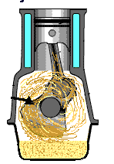
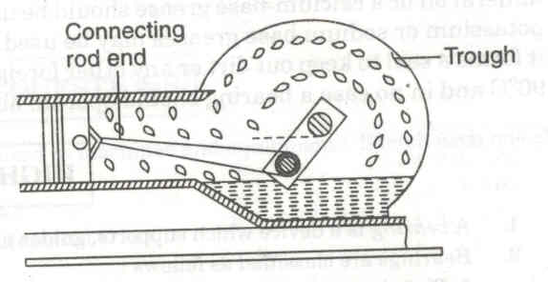
Splash lubrication:
Commonly used lubrication systems in I.C. Engines

Slide 11
Splash lubrication:
Commonly used lubrication method in I.C. Engines
Splash lubrication is generally used in a 4 stroke IC engine to lubricate parts such as cylinder, piston, gudgeon pin, connecting rod, bearings etc.
The oil is contained in the crank case of the engine.
As the piston reciprocates up and down the crank with the big end of the connecting rod partly dips into the oil sump and continuously splashes the oil to the surfaces of the cylinder and the piston.

